Slide 1

Futurense
Democratizing Tech Talent to deliver impact at scale

Slide 2
Walmart Project Analysis and Stock Project

Slide 3
Overview:
Method for Investors and Traders to make Buying and Selling Decisions. Fundamental hare Market Analysis is about using Real data to evaluate a Stock's Value.
Developed analysis that allows trading firms to analyze large patterns of stock market data and loop For possible permutations to increase returns and reduce risk. Performing the Financial Analysis on Historic Stock Market Data such as calculating various risks, returns, etc.

Slide 4
Tools and Technologies Used:
HIVE
HBASE
RDBMS
PYSPARK
SPARK SQL
SPARK STREAMING
PowerBI

Slide 5
Libraries/Packages/Features Used:
Findspark, pyspark, SparkSession,StreamingContext
StructField, IntegerType, StructType, StringType, FloatType, DateType
col, format_number

Slide 6
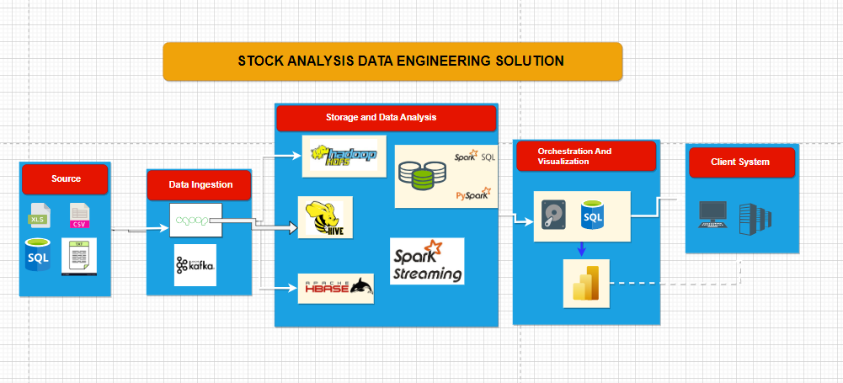
ARCHIETECTURE FLOW

Slide 7
Walmart Stock Analysis:
We have columns like Date, Open, Close, High, Low, Volume, Adjusted Close.
We have 1258 records and with different stocklabels

Slide 8
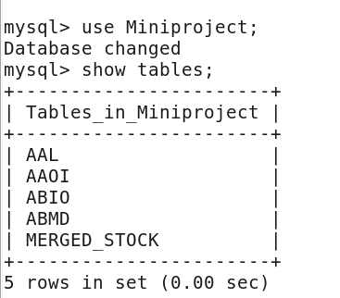
HIVE ANALYSIS
Created database Miniproject in mysql and created all tables in that db
Created tables structures for all table in mysql database for loading data.
Loaded the data from local to the mysql tables created for all tables.

Slide 9
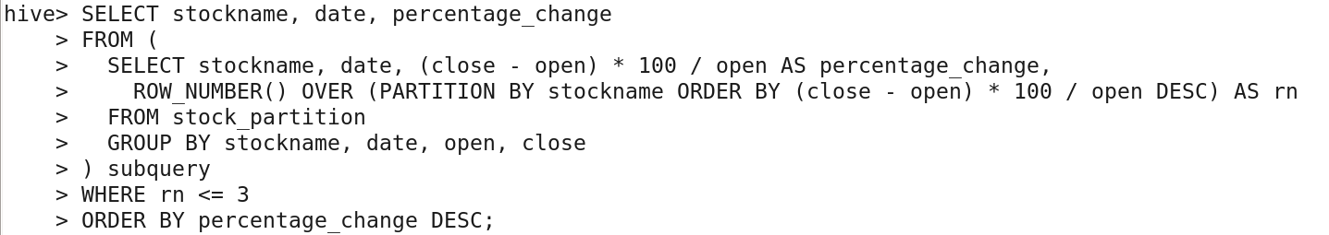
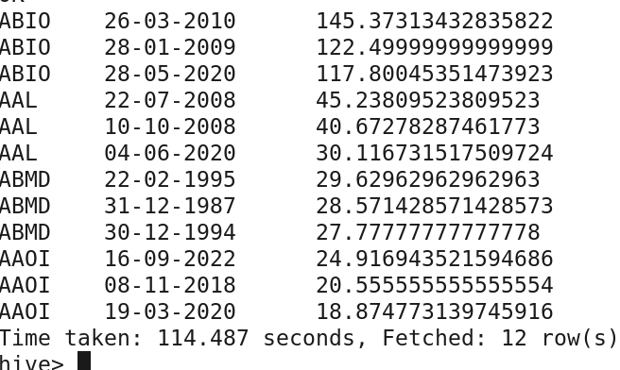
Q. Write a Hive query to identify the top three dates that experienced the largest percentage change in stock price (from open to close) for every stock.

Slide 10
HBASE
Scenario 1: We have used Hbase for this scenario
Created Table in Hbase.
We used Sqoop to import data from MySQL to Hbase.

Slide 11
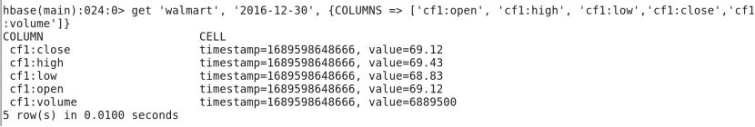
Display out first 5 columns.

Slide 12
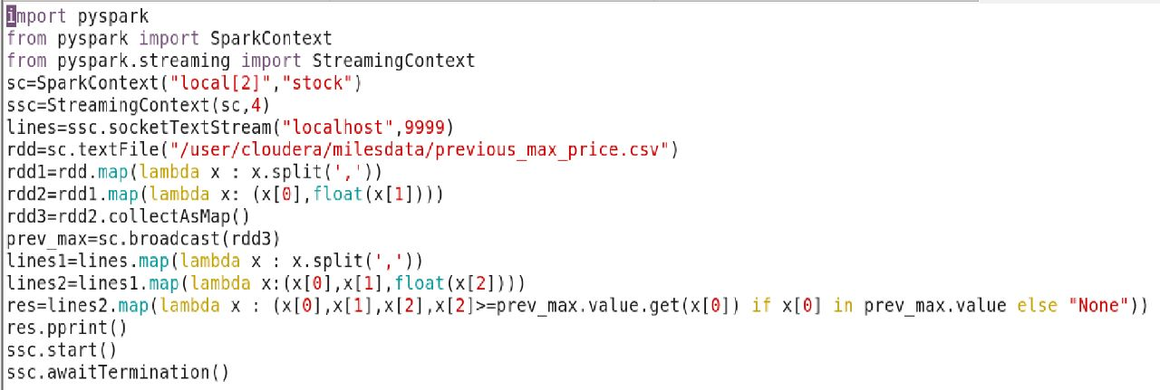
STREAMING ANALYSIS
Scenario: We have NYSE stock data set. One file has the maximum stock price of the previous day consisting of stock symbol
of the company and the previous max price. The other is streaming data each record of which consists of the stock
symbol, time stamp in HH:MM:SS format and the current stock price.

Slide 13
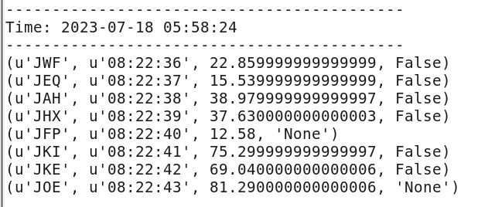

Slide 14
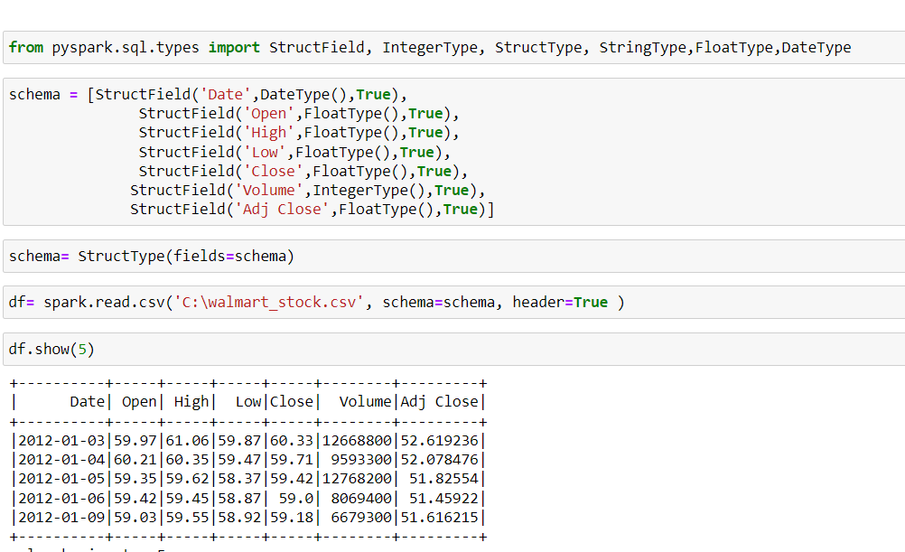
SPARK-SQL
scenario:There are too many decimal places for mean and stddev in the describe() dataframe. Format the numbers to just show up to two decimal places. Pay careful attention to the datatypes that .describe() returns, we didn't cover how to do this exact formatting, but we covered something very similar.

Slide 15
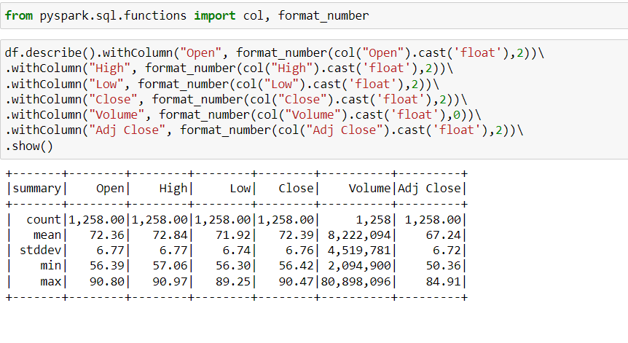

Slide 16
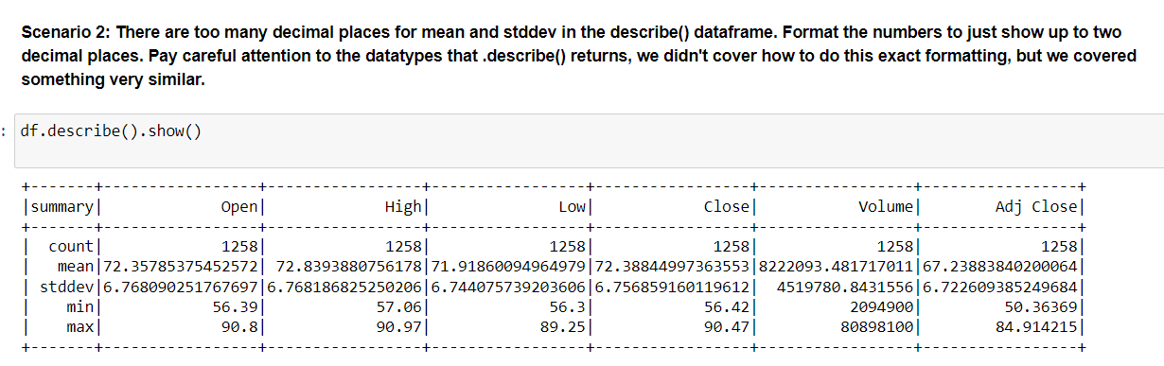
OUTPUT:

Slide 17
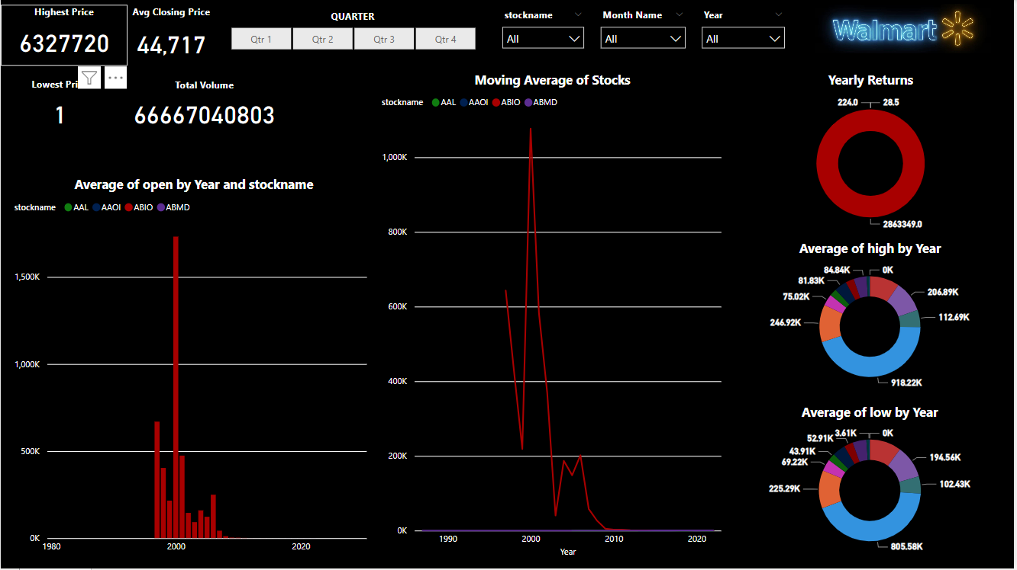
Power BI Dashboard

Slide 18
Thank You

